Slide 1



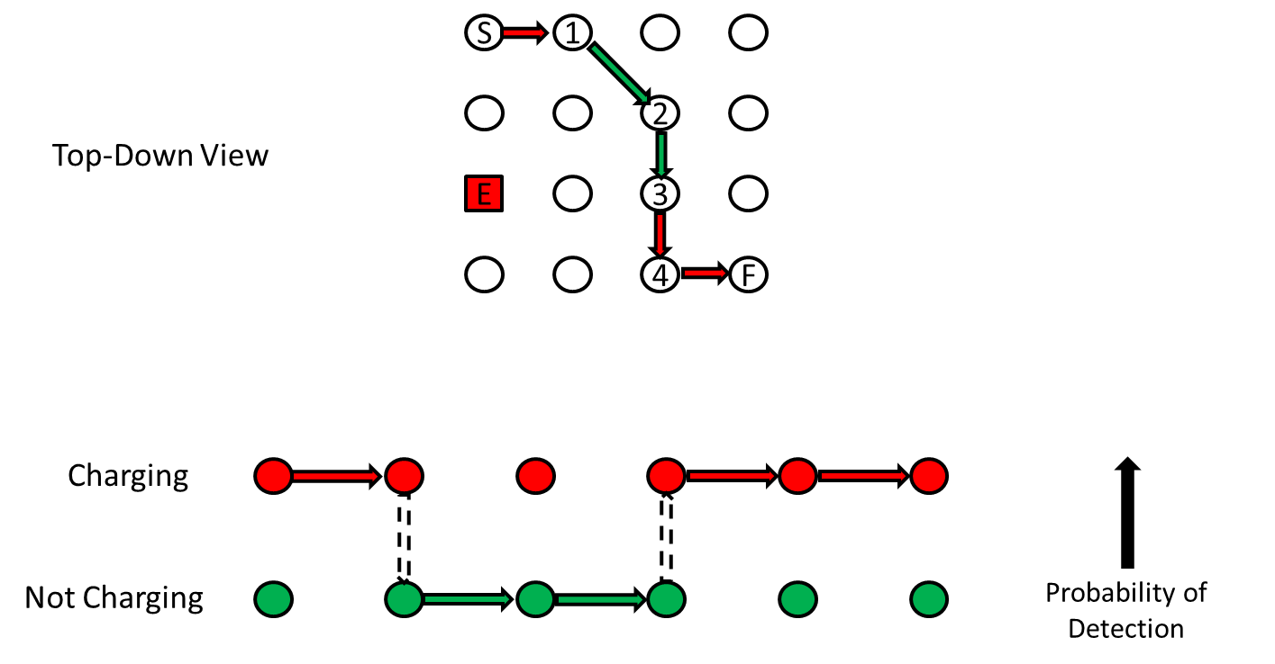
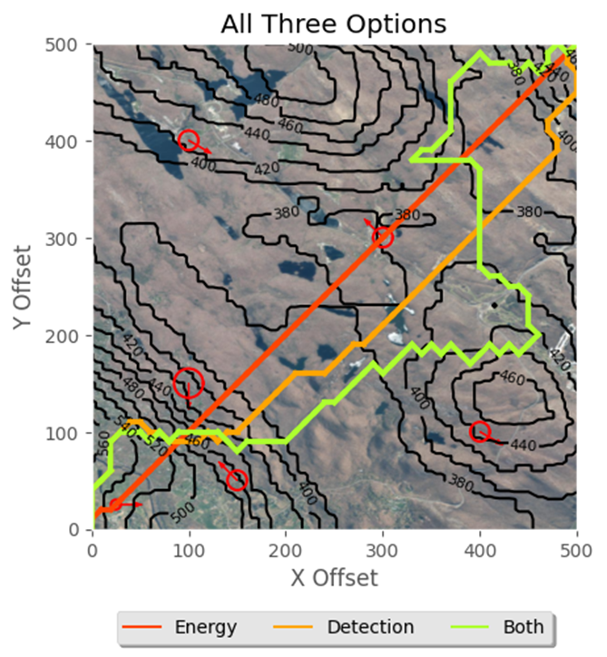
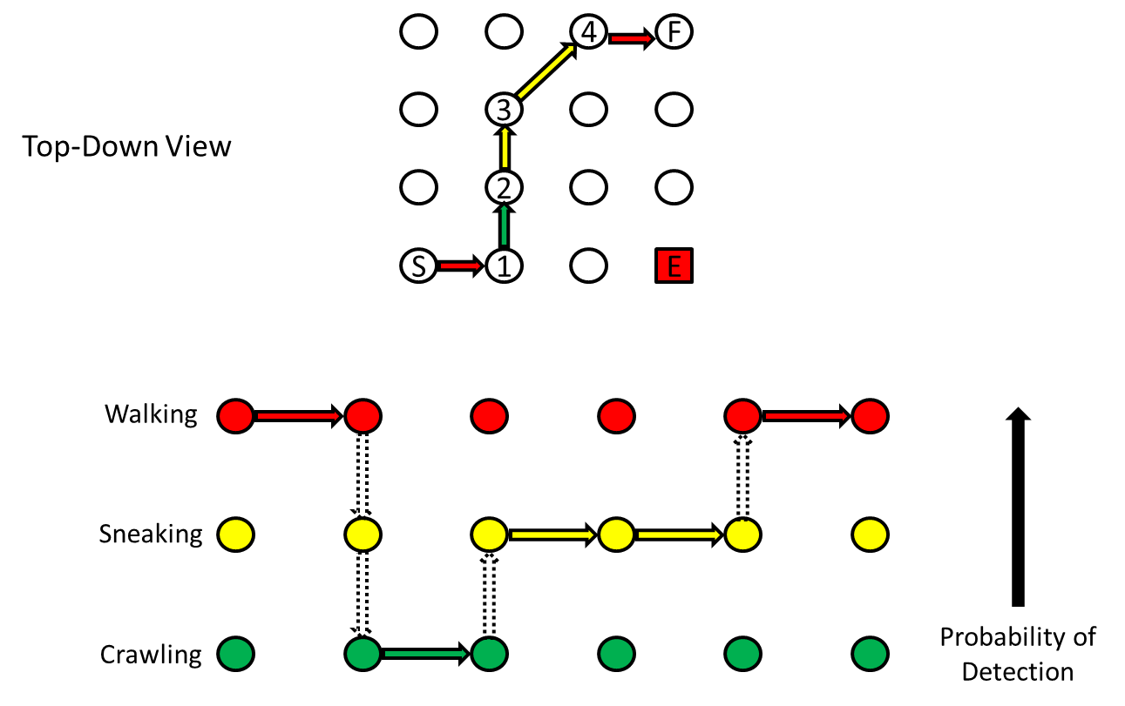

_{Optimized Tactical Routing for} _{Unmanned Ground Vehicles} Cadet Jacob Hyatt Advisors: LTC James Grymes, COL Corey James, and Dr. Robert Jane
Please delete this text box and the red dashed border once your poster is complete, anything outside of the red dashed line will be covered by the poster frame!
Problem Statement
Military autonomous vehicles, particularly electric or hybrid variants traversing terrain, are unlikely to complete their specific mission unless they can avoid detection and manage their onboard energy sources. These two critical criteria are often at odds with one another. We aim to create a path planning tool for unmanned ground vehicles, while minimizing the risk of detection and expended energy.
Previous Work
Previous work focused on creating an optimal path for a human in a contested environment. We allowed the human to have three different forms of movement that had different effects on the likelihood of detection as seen in Figure 1.
We leveraged satellite-derived vegetation data, introduced multiple enemies with varied capabilities, and enhancing the probability models for more realistic assessments.
Leveraging these projections, we employed a modified A* algorithm to plan routes that meet mission time constraints while minimizing detection risk.
Fig 1. Previous Methods for Human
Methodology
Utilizing a Digital Elevation Model (DEM) and Normalized difference vegetation index derived from Landsat 8 imagery we create an accurate picture of the area of operations.
Emplace enemies in various locations and calculate the edge weights for energy consumption and detection likelihood.
Utilize Gurobi to run the multi-objective function subject to realism constraints
Generate imagery for the commander to choose a course of action
Fig 2. Overview of Methodology
Optimization Function
Detection Cost
Utilizes visual and audio detection functions built for humans but adapted for unmanned ground vehicle
Audio leverages the probability of being heard over the background noise of the area of operations
Visual detection utilizes line of sight and the total space that the UGV takes up in a human’s eye at distance r
Energy Cost
Drive train simulation of unmanned ground vehicle
Calculates energy in kJ that it takes to move from one node to another
Vehicle has regenerative braking and an onboard 5kW generator
Optimization Function
$α$ and $β$ can be changed to alter the weight of detection or energy cost
We minimize the total likelihood of detection when an arc is taken plus the scaled total energy cost of the path taken
Eq 1. Multi-Objective Optimization Function
Results
Fig 3. Results with Different Objective Weights
Conclusion
Make this about the results above
Previous methods of path creation for humans can be applied to unmanned ground vehicles to the same effect. Allowing for the customization of weights for both detection and energy consumption allows for a pareto frontier of decisions a commander can make.
References
1. Kendall, Thomas P., Daniel T. Killian, and Matthew J. Koch. "Optimized Tactical Route Planning." Military Operations Research Journal 28, no. 4 (2023): 5-21.
Acknowledgments
Project Sponsor: Army Research Laboratory

